Slide 1




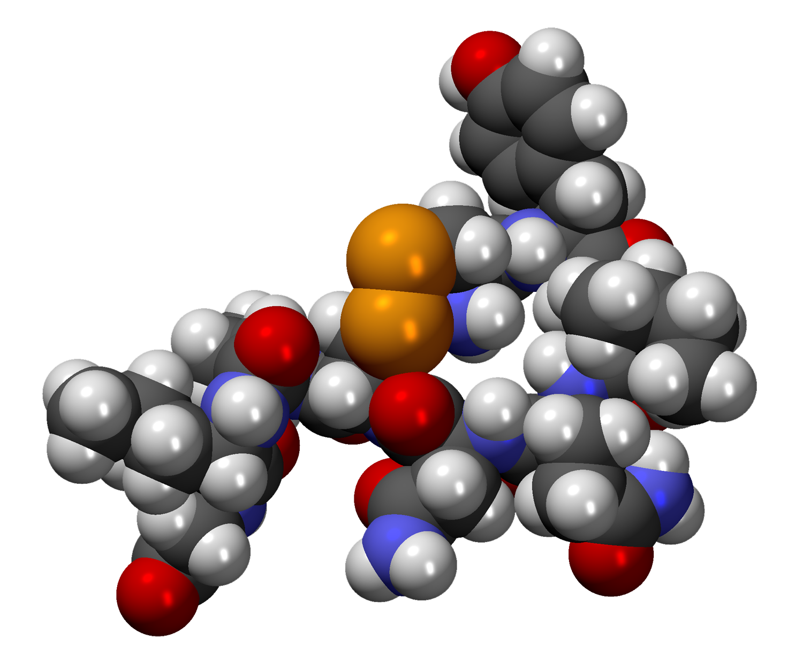
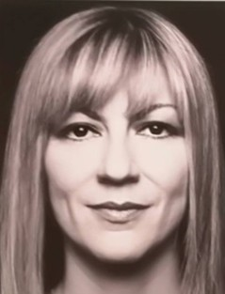
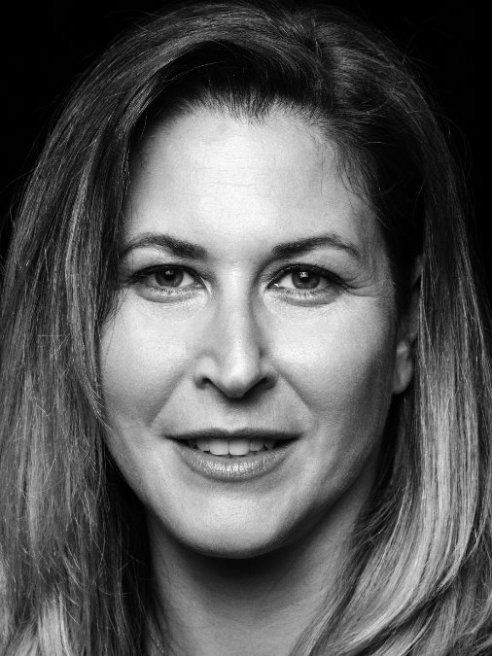

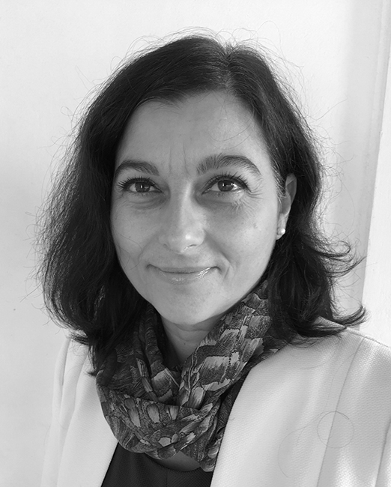
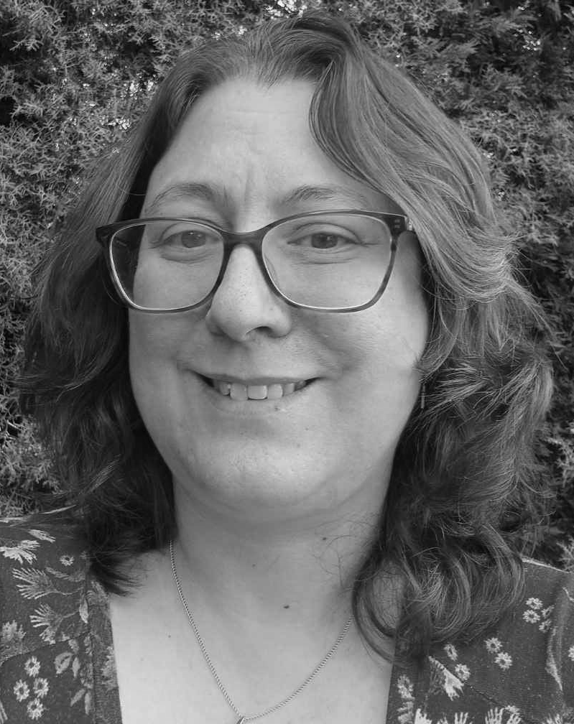

Global Women’s Breakfast
February 10th , 2026
Many Voices, One Science
Academia
Academia
Dr. Eleni Efthimiadou
Dr. Eleni Makarona
Public Sector
Education
Elpida Fotiadou,
MSc
10:00 am - 12:00 pm
Industrial Chemistry Auditorium A2
DEPARTMENT OF CHEMISTRY, NKUA
Alexandra Iliadi,
MSc

